Slide 1

Office Supplies of Honda Canada
Vivian Jingqi Chang
April 6th, 2021

Slide 2

Agenda
How did the budget be allocated?
Which transaction type is most common?
How about the needs of equipment trend?
Other relative analysis

Slide 3

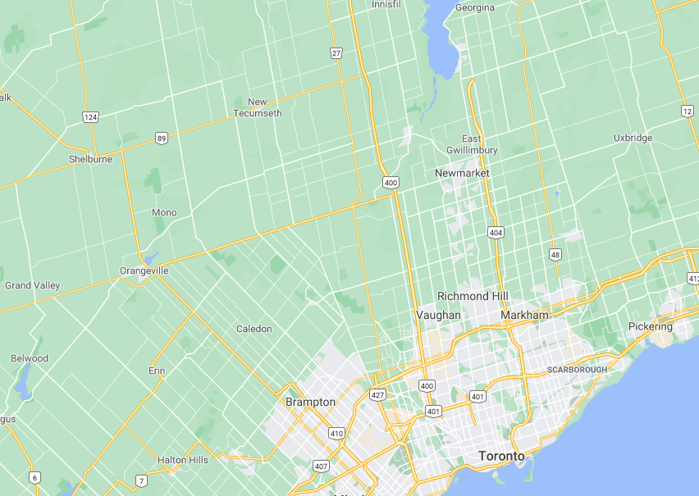
Address located
Alliston
Markham: 180 Honda BLVD
Markham
Alliston: 4700 Industrial PKY
6900 Industrial PKY

Slide 4
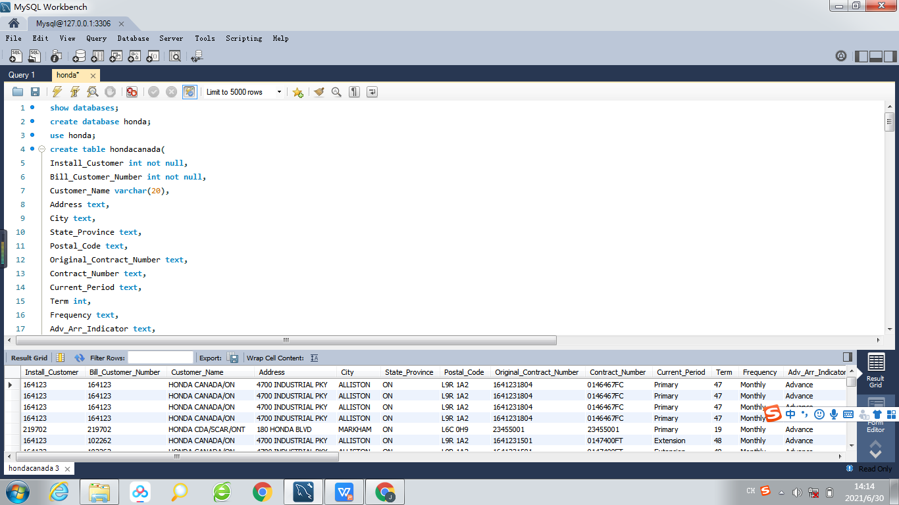
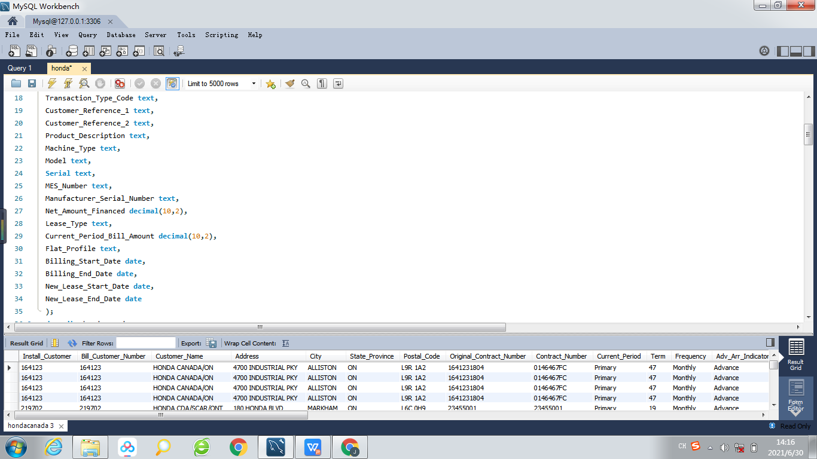
Create database 'honda' and table 'hondacanada'

Slide 5
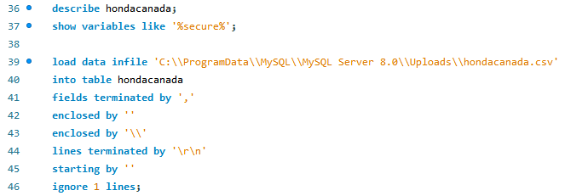
Load file into table 'hondacanada'
describe the table's type and find the default path to extract file

Slide 6
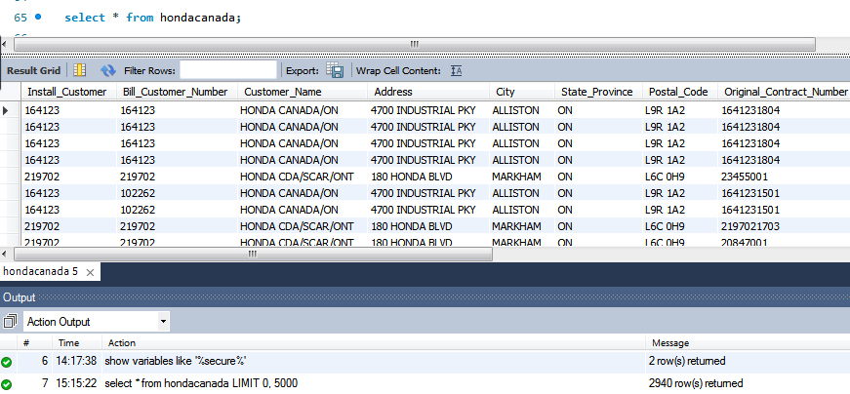
Show and check all columns and records
hondacanada.csv has 2940 records

Slide 7
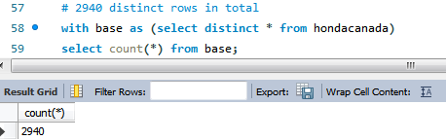
Check duplicate records
There are 2940 records when select distinct * from table, which is the same number when directly select all from table. So every row is unique in the raw table.

Slide 8
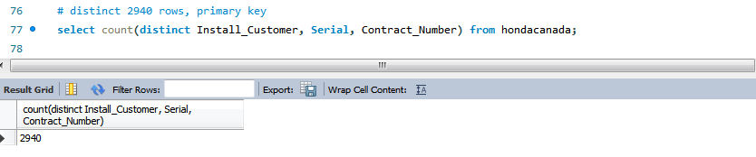
Primary Key
Combine three fileds to establish primary key.
In raw data every column has duplicate cells.

Slide 9
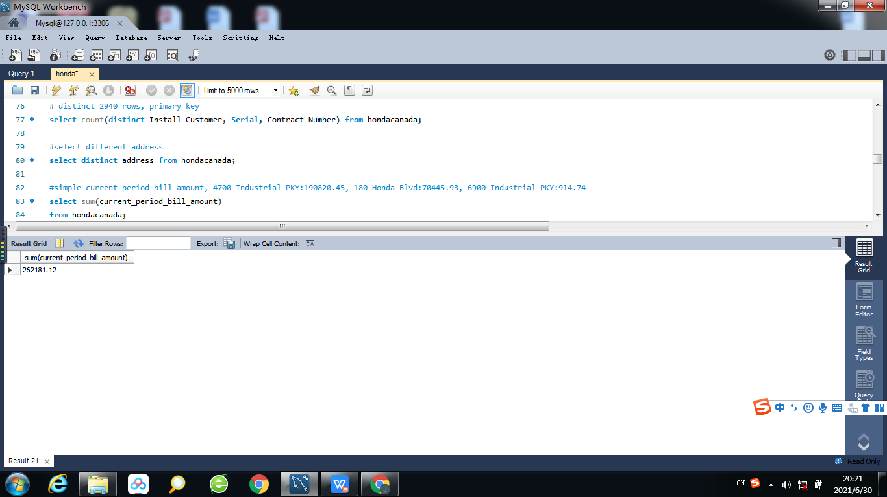
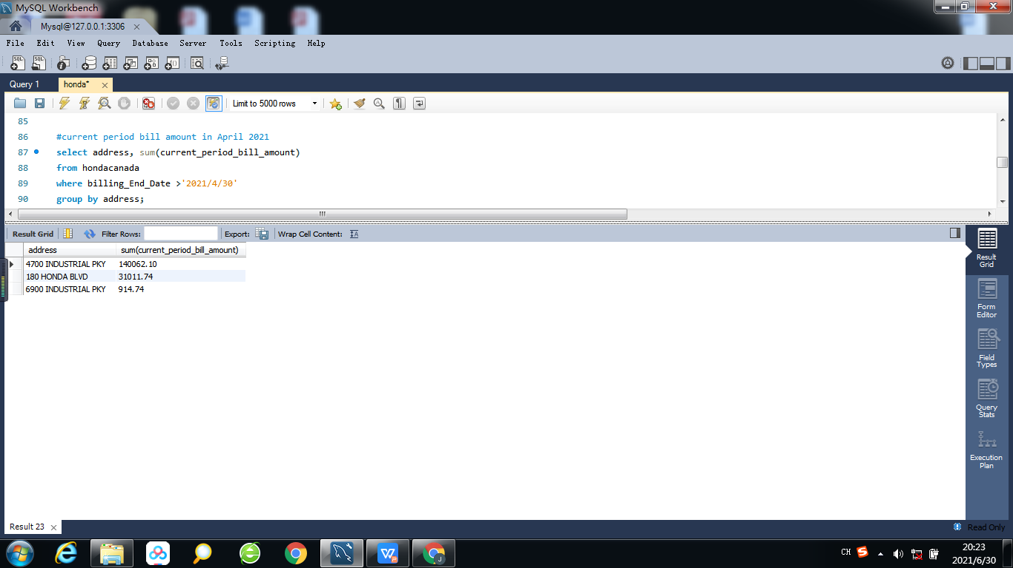
Current period bill amount
Total current period bill amount
Current period bill amount valid until April

Slide 10
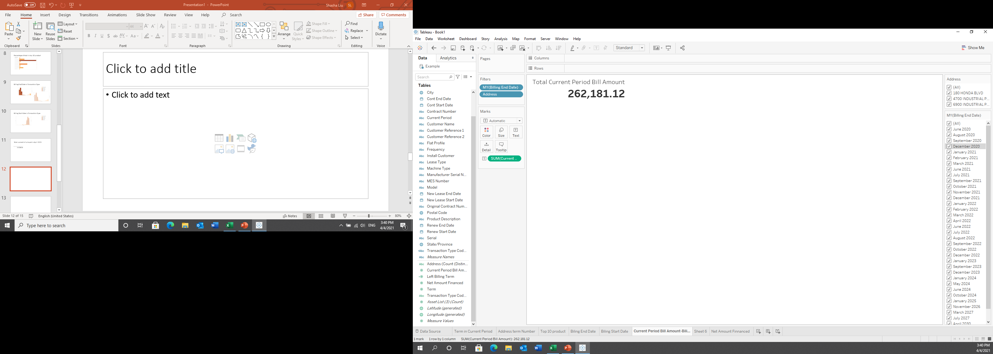
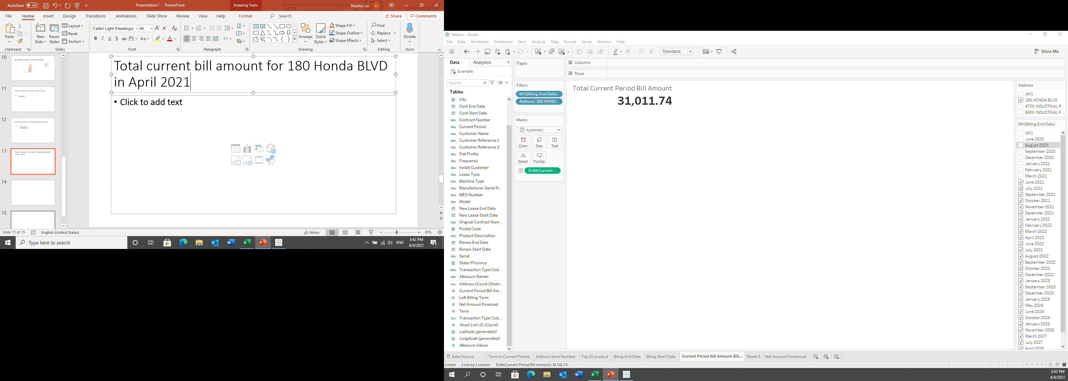
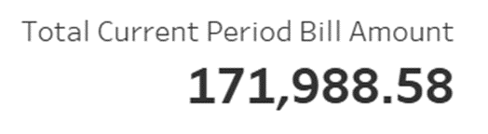
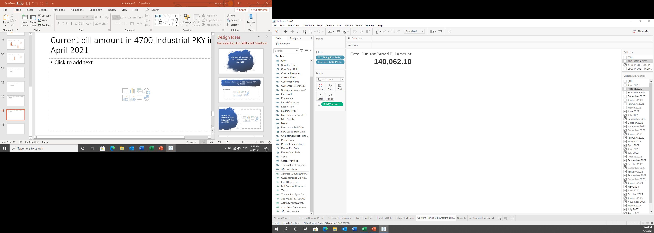
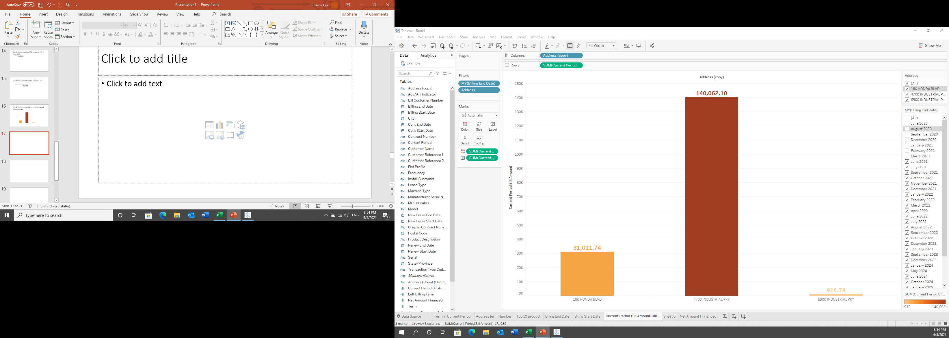
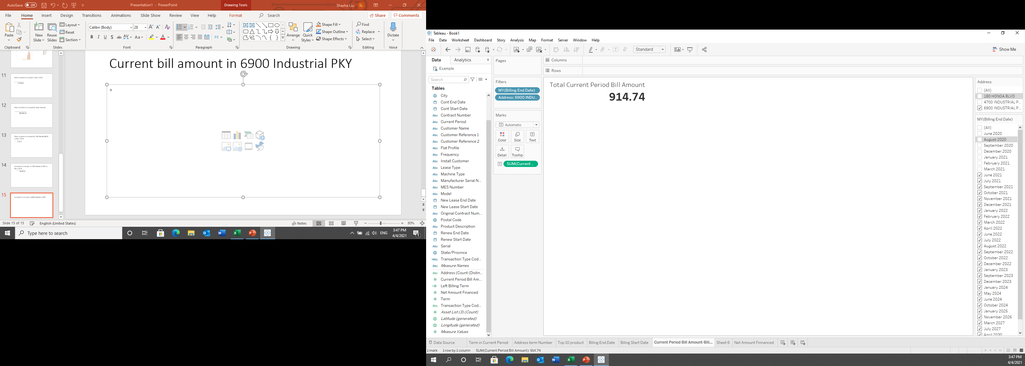
Current Period Bill Amount
In 180 Honda BLVD in April 2021
Bill amount in April 2021
In 4700 Industrial PKY in April 2021
In 6900 Industrial PKY in April 2021

Slide 11
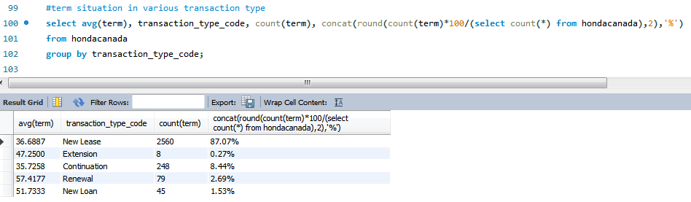
Compare different transaction type

Slide 12
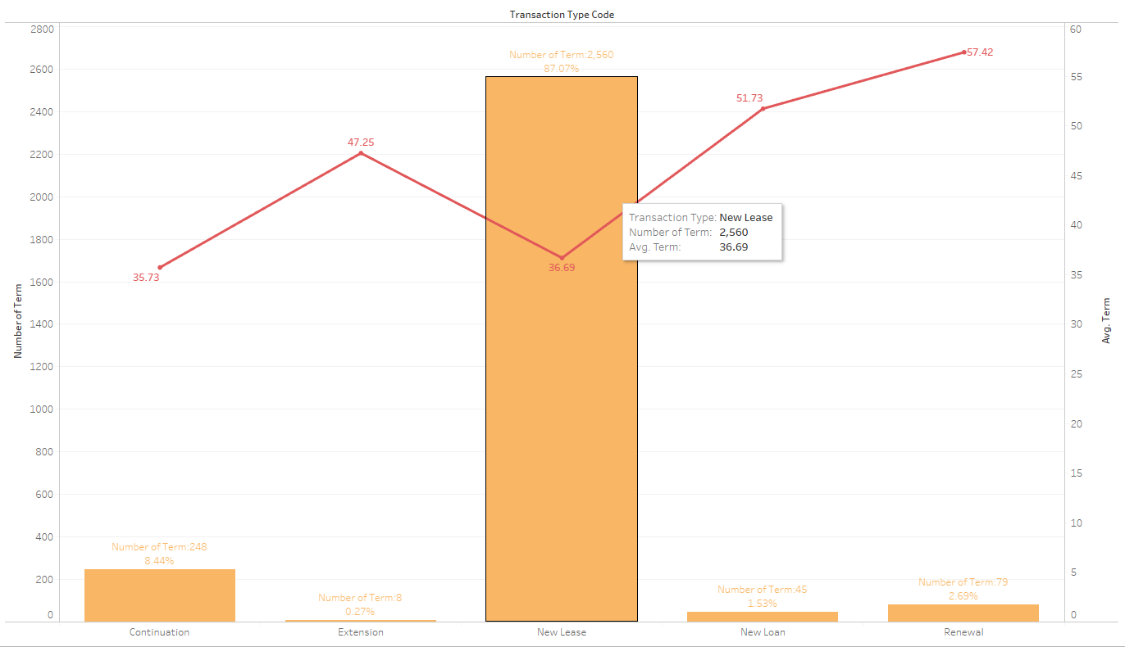
Term Situation in all address
New Lease is the most common transaction type, and its average term period is 36 months

Slide 13
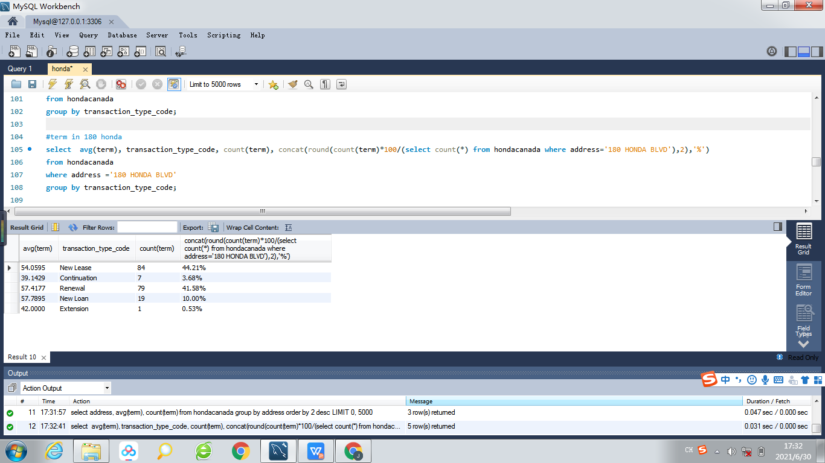
Term&transaction in 180 Honda Blvd

Slide 14

Term&transaction in 4700 Industrial PKY

Slide 15
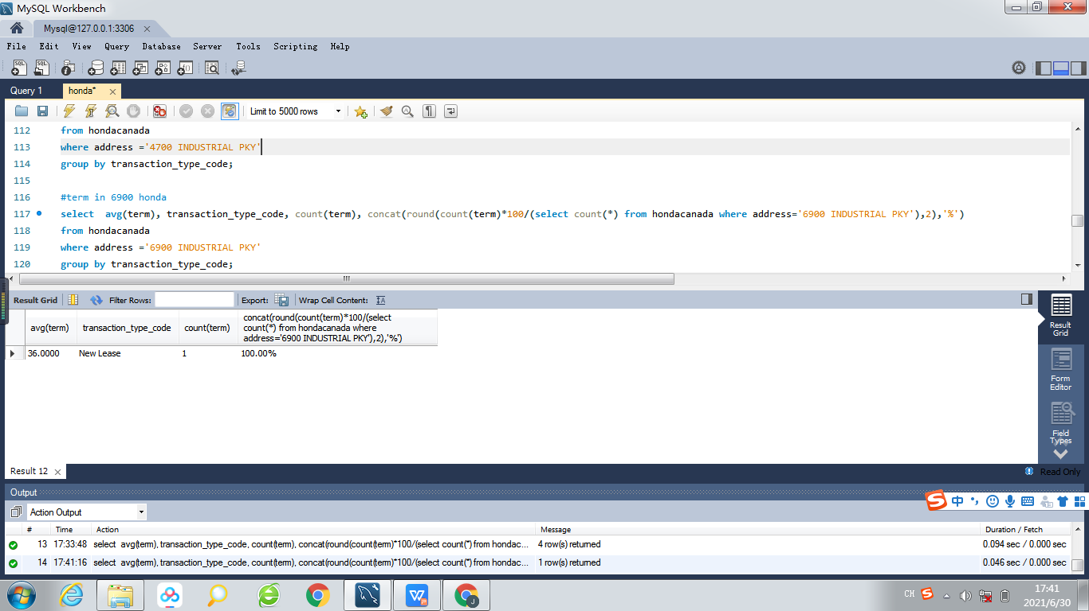
Term&transaction in 6900 Industrial PKY

Slide 16
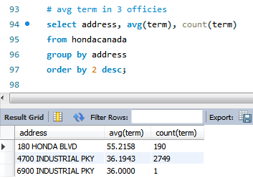
transactions occured in different addresses

Slide 17
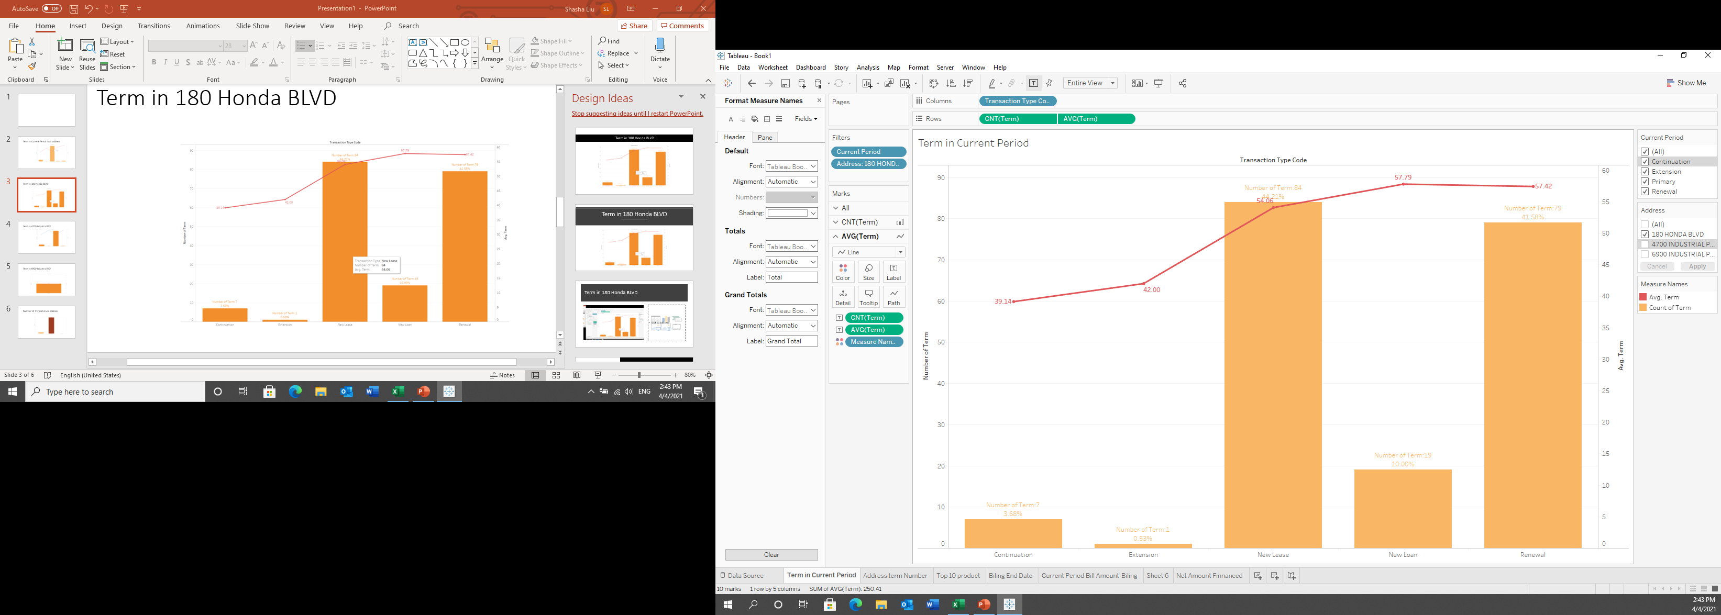
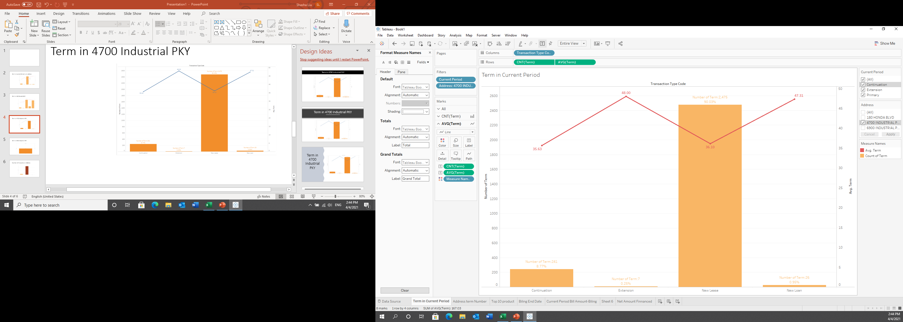
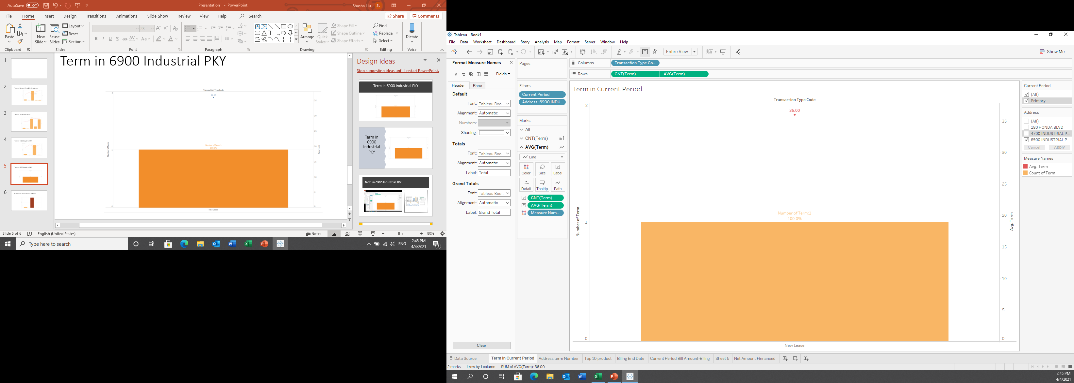
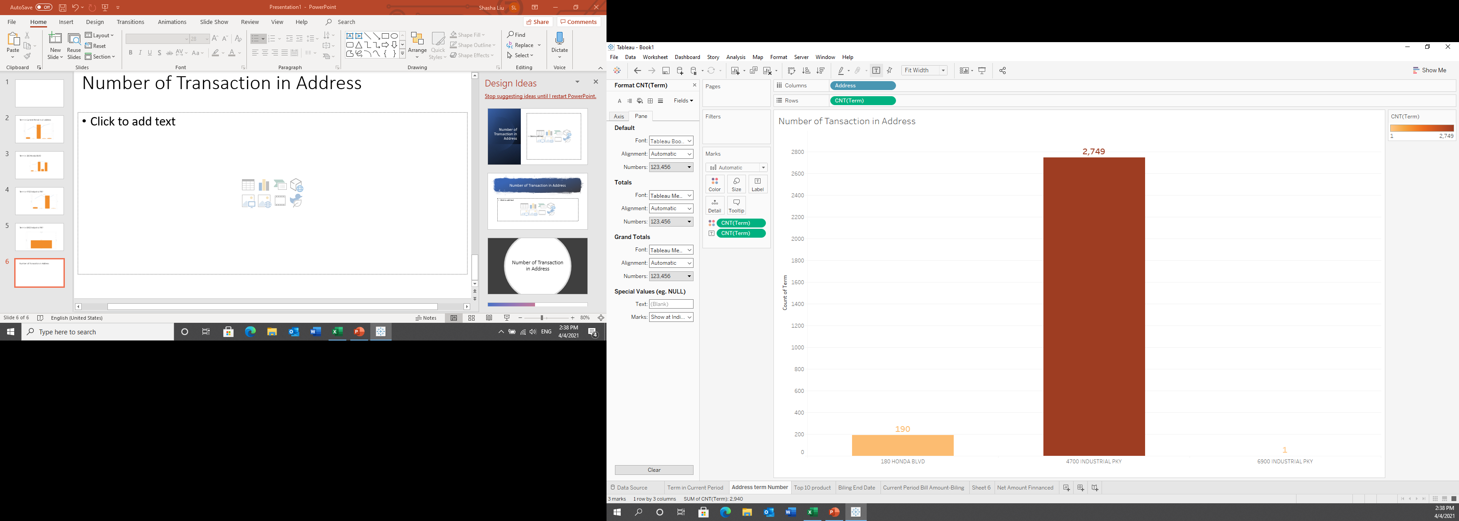
Term in 180 HONDA BLVD
Term in 4700 INDUSTIAL PKY
New Lease & Renewal are the most common transaction Type in 180 Honda Blvd
Average term is 55 months
New Lease is the most popular transaction Type in 4700 Industrial PKY
Avg term is 36 months
Term in 6900 INDUSTRIAL PKY
Number of Transaction in Address
4700 INDUSTRIAL PKY has the highest frequency in transaction

Slide 18

Compare net amoount financed

Slide 19
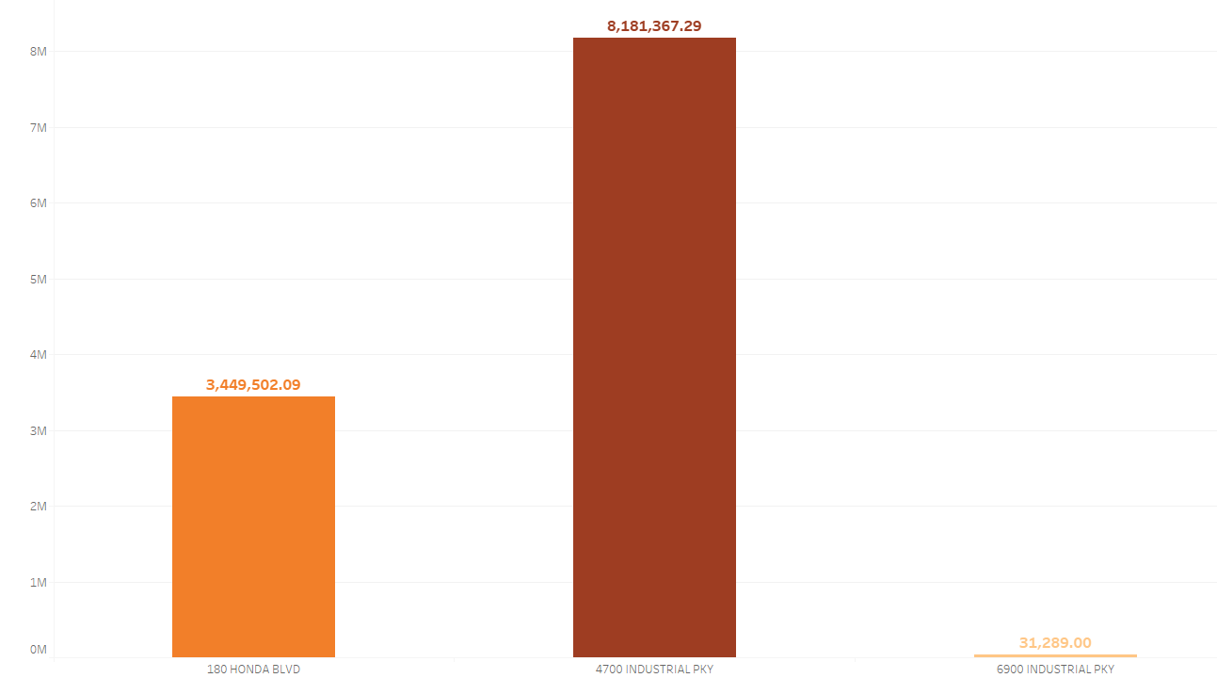
Net Amount Financed
Net Amount Financed in 4700 is about twice as much as in 180 Honda

Slide 20
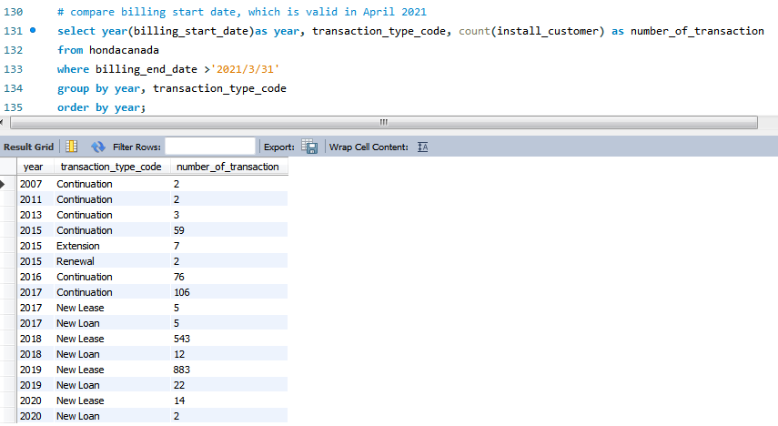
Billing start date valid in April

Slide 21
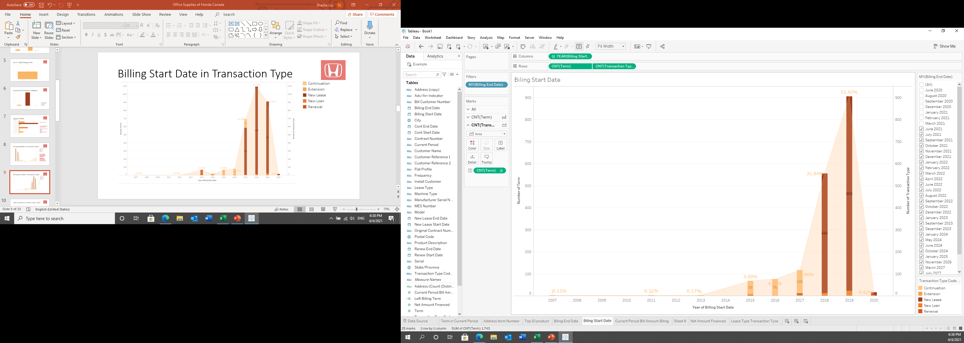
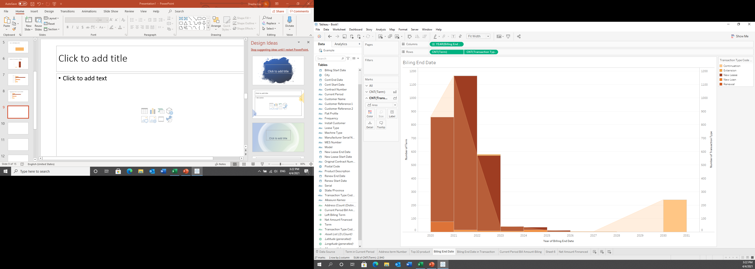
Billing Start Date in Transaction Type
Increase Trend
In 2018 and 2019 new lease is the most common transaction type
Between 2015 and 2017 continuation is the most popular transaction type to have supplies
Exclude Expired Billing End date

Slide 22
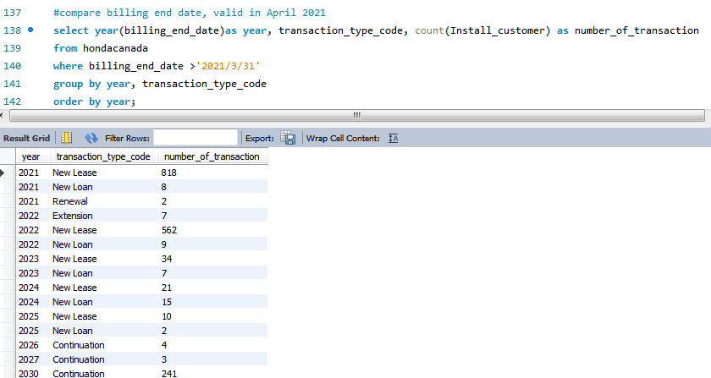
Billing end date valid in April

Slide 23
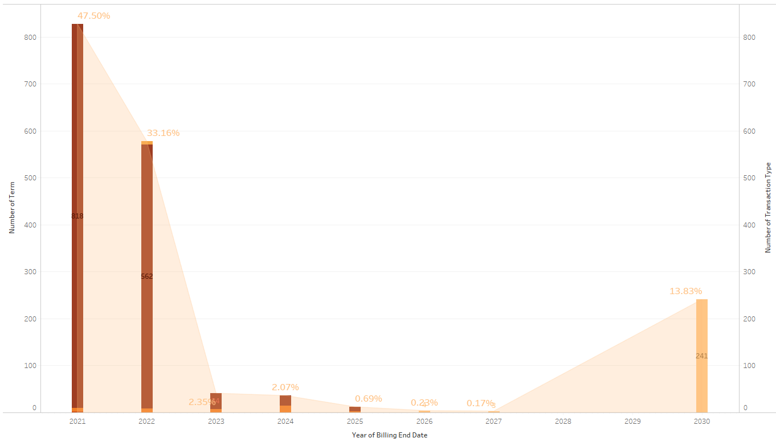
Billing End Date in Transaction Type
For the nearest 2 years, new lease supplies will reach bill end date
continuation product is occupied around 14% and will end bill in 2030

Slide 24
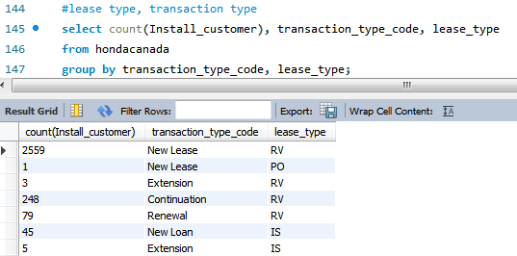
Relation of transaction type&lease type

Slide 25
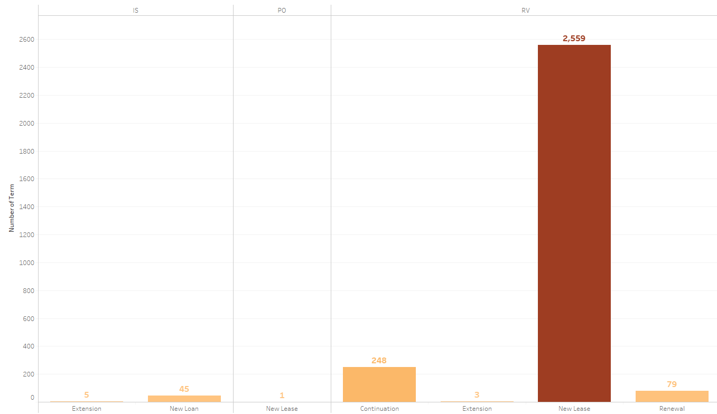
Lease Type - Transaction Type
RV is the most popular way to lease supplies
easier
flexible
lower interest

Slide 26
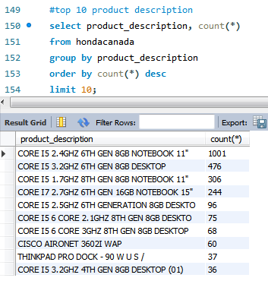
The most 10 rent products

Slide 27
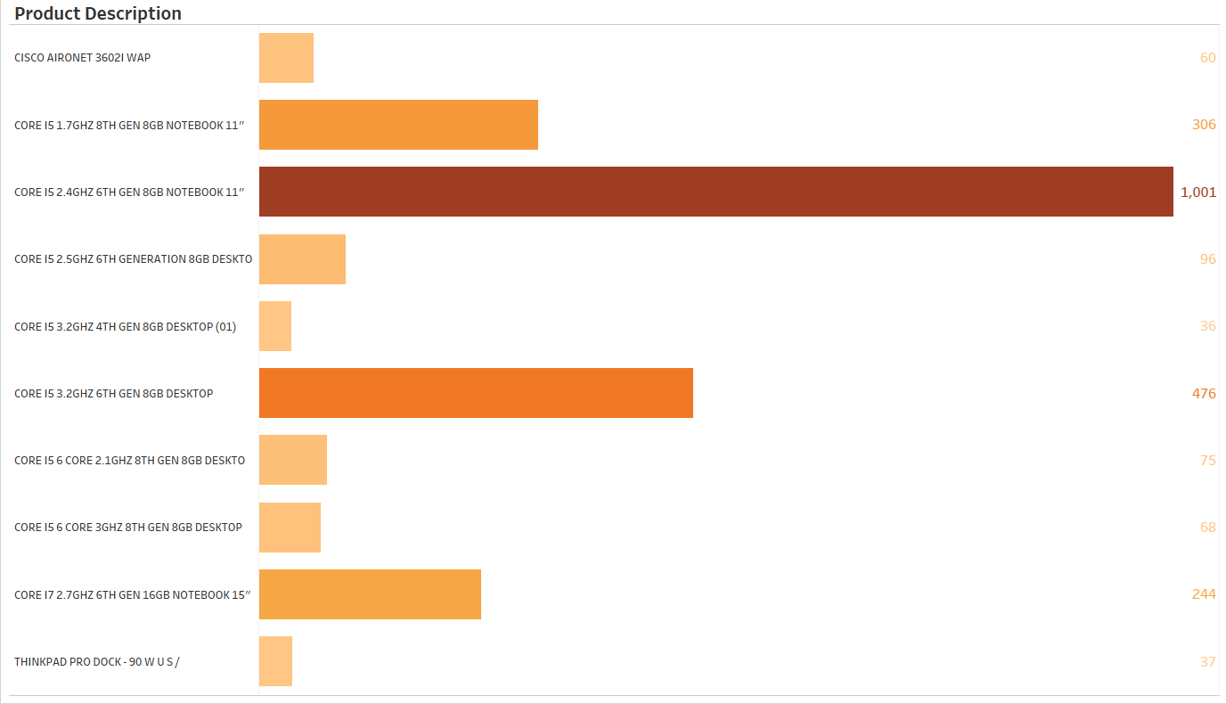
Top 10 Product
81.6% of all products
CORE I5 2.4GHZ 6TH GEN 8GB NOTEBOOK 11”
Average Net Amount Financed: 1471.84
Term:
36 Months
Average Current Bill Amount: 37.25
Separate the information and find Core I5, 6TH, 8GB has the highest frequency occurred in datasets

Slide 28
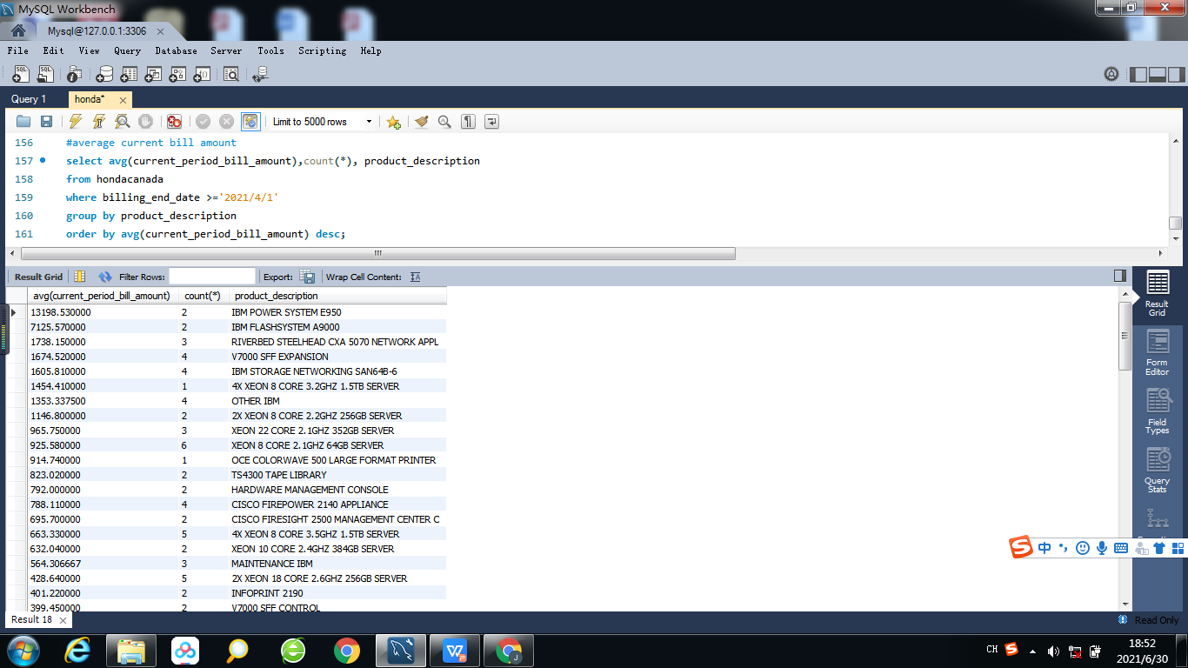
Average current bill amount

Slide 29
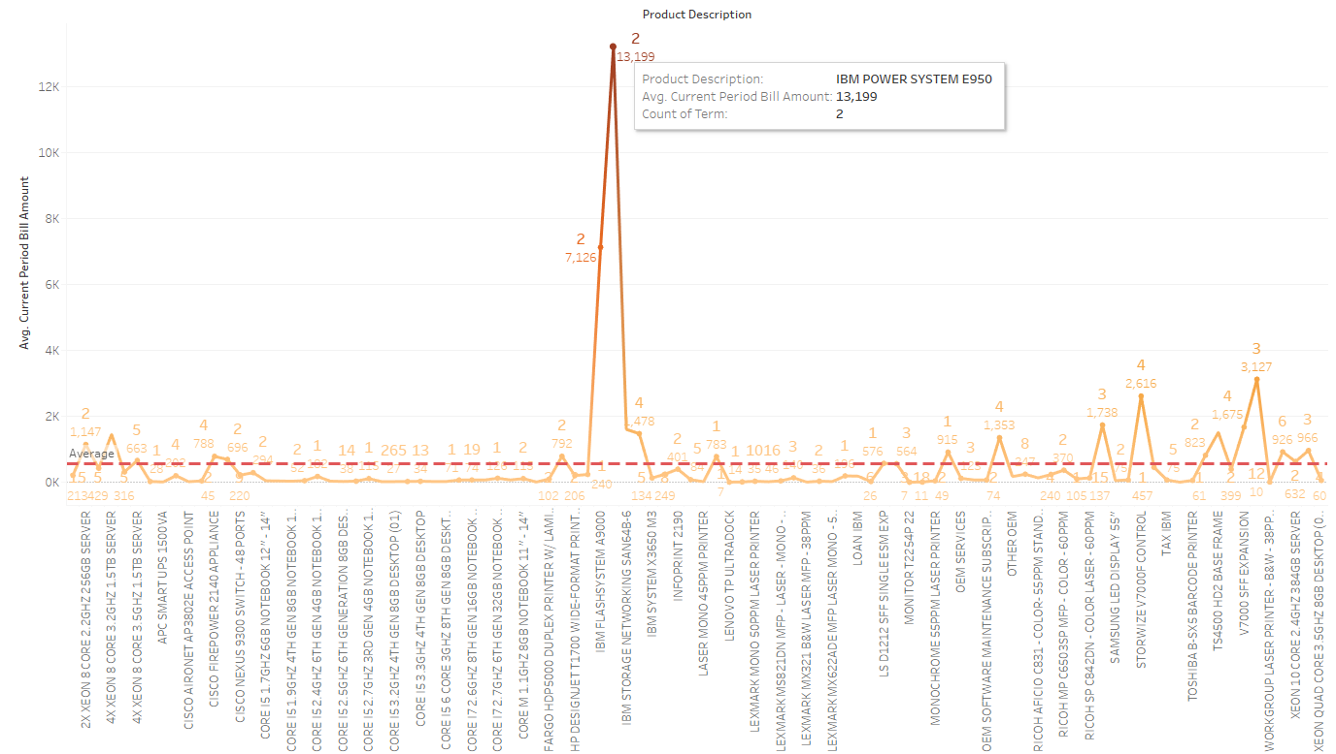
Average Current Bill Amount in Products
Average Current Bill Amount for type of product is 565 in April 2021
IBM POWER SYSTEM E950 cost the highest average : 13199
IBM FLASHSYSTEM A9000 is the second expensive product

Slide 30
Conclusion
4700 Industrial PKY has bigger business
New lease is the most common transaction Type
RV is the first lease type choise
Less lease occurred after Feb 2020

Slide 31

Thank you!
Q&A

